Slide 1
Hovercraft VDP 2
Group 13
Paul Longe
Bradley
Keqi
Divine
Xiang
Alex

Slide 2
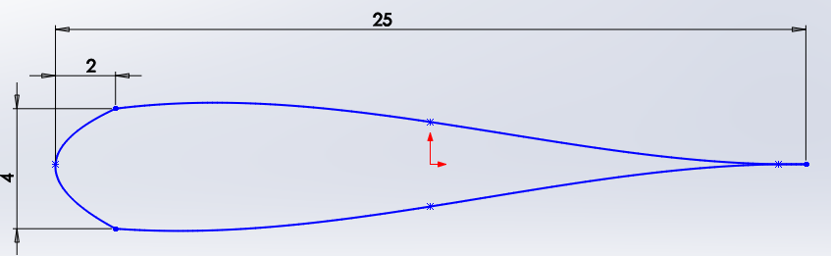
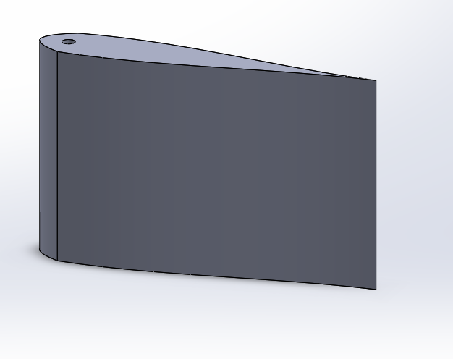
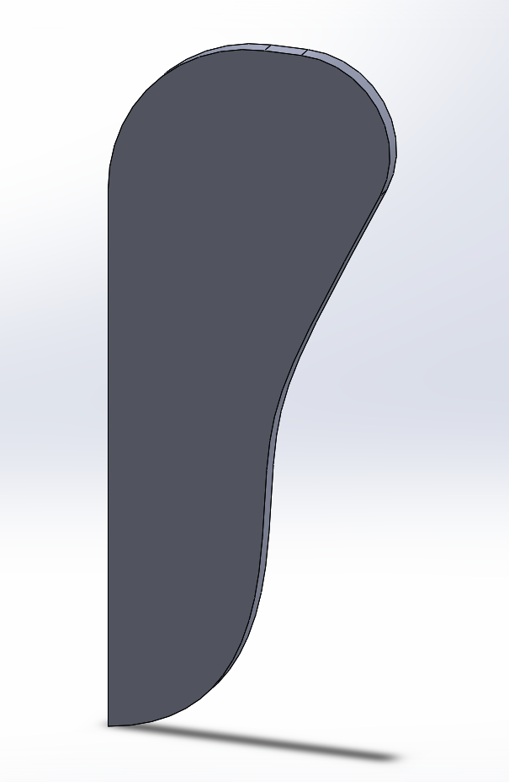
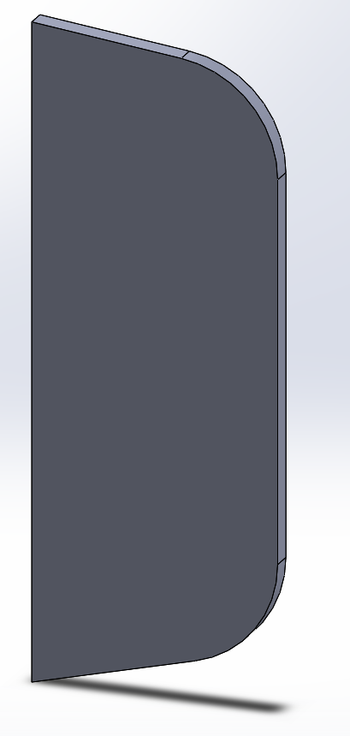
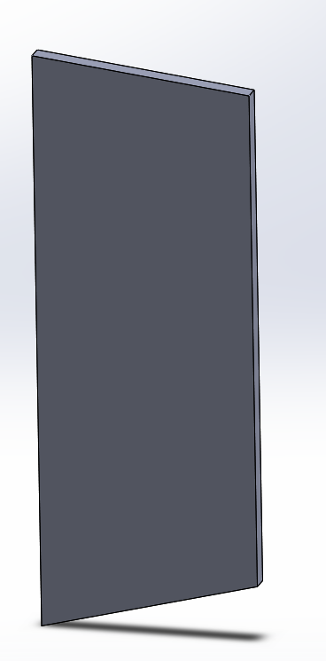
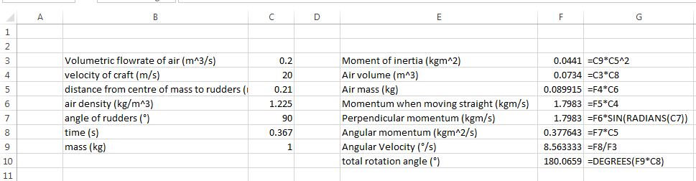
Turning – Final Design
Paul Longe – Integration Engineer
In order to turn the hovercraft, the use of rudders was selected as it was the option that best fulfilled selection criteria.
Rudders can be made with a cheap material, and are easy to manufacture.
Having more than one rudder increases the amount of air that can be redirected, the rudders needs to have a synchronized movement system. A simple linkage was chosen over a more complex 4 bar system.
Radius of turn needs to be minimized, this is done by redirecting more air flow through a symmetrical airfoil design to minimize air drag. And through having two rudders rather than just one.
The rudder is secured through the use of pins attached to the cowling. The location of the pin is in the thickest part of the rudder as it will bear high amounts of load.
There is a 4mm tolerance between the height of the rudder and the parts to secure it
Although it is difficult to calculate how much airflow the rudders are able to redirected, I have done calculations to show how much rotation can be achieved over a time period with the rudders set to different angles.
The table displays total angle turned over a time period at different angles of the rudder. It shows a 10° increase in rudder angle results in a 8.5% increase in turn for all times
Rudder angle 60°
Time (s) | Angle turned(°)
0.1 | 11.58
0.2 | 46.31
0.3 | 104.20
0.4 | 185.25
Rudder angle 70°
Time (s) | Angle turned(°)
0.1 | 12.56
0.2 | 50.25
0.3 | 113.06
0.4 | 201.00

